Slide 1
Chapter 11 Properties of Stock Options

Slide 2
Notation
c: | European call option price
p: | European put option price
S₀: | Stock price today
K: | Strike price
T: | Life of option
σ: | Volatility of stock price
C: | American call option price
P: | American put option price
S_{T}: | Stock price at option maturity
D: | PV of dividends paid during life of option
r | Risk-free rate for maturity T with cont. comp.

Slide 3
Effect of Variables on Option Pricing (Table 11.1, page 235)
Variable | c | p | C | P
S₀ | + | − | + | −
K | − | + | − | +
T | ? | ? | + | +
σ | + | + | + | +
r | + | − | + | −
D | − | + | − | +

Slide 4
American vs European Options
An American option is worth at least as much as the corresponding European option
C ≥ c
P ≥ p

Slide 5
Calls: An Arbitrage Opportunity?
Suppose that
Is there an arbitrage opportunity?
c = 3 | S₀ = 20
T = 1 | r = 10%
K = 18 | D = 0

Slide 6
Lower Bound for European Call Option Prices; No Dividends (Equation 11.4, page 240)
c ≥ max(S₀ –Ke ^{–rT}, 0)

Slide 7
Puts: An Arbitrage Opportunity?
Suppose that
Is there an arbitrage opportunity?
p= 1 | S₀ = 37
T = 0.5 | r =5%
K = 40 | D = 0

Slide 8
Lower Bound for European Put Prices; No Dividends (Equation 11.5, page 241)
p ≥ max(Ke ^{-rT}–S₀, 0)

Slide 9
Put-Call Parity: No Dividends
Consider the following 2 portfolios:
Portfolio A: European call on a stock + zero-coupon bond that pays K at time T
Portfolio C: European put on the stock + the stock

Slide 10
Values of Portfolios
 |  | S_{T} > K | S_{T} < K
Portfolio A | Call option | S_{T} − K | 0
 | Zero-coupon bond | K | K
 | Total | S_{T} | K
Portfolio C | Put Option | 0 | K− S_{T}
 | Share | S_{T} | S_{T}
 | Total | S_{T} | K

Slide 11
The Put-Call Parity Result (Equation 11.6, page 242)
Both are worth max(S_{T} , K ) at the maturity of the options
They must therefore be worth the same today. This means that c + Ke ^{-rT} = p + S₀

Slide 12
Arbitrage Opportunities
Suppose that
What are the arbitrage possibilities when
p = 2.25 ?
p = 1 ?
c= 3 | S₀= 31
T = 0.25 | r = 10%
K =30 | D = 0

Slide 13
Early Exercise
Usually there is some chance that an American option will be exercised early
An exception is an American call on a non-dividend paying stock
This should never be exercised early

Slide 14
An Extreme Situation
For an American call option:
S₀ = 100; T = 0.25; K = 60; D = 0
Should you exercise immediately?
What should you do if
You want to hold the stock for the next 3 months?
You do not feel that the stock is worth holding for the next 3 months?

Slide 15
Reasons For Not Exercising a Call Early (No Dividends)
No income is sacrificed
You delay paying the strike price
Holding the call provides insurance against stock price falling below strike price

Slide 16
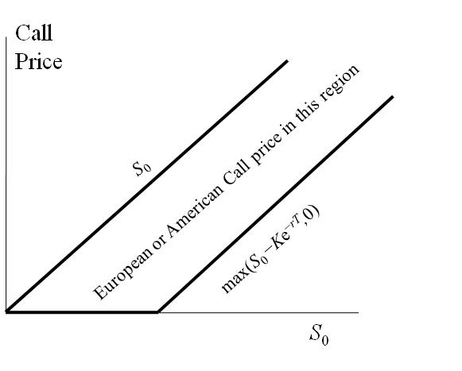
Bounds for European or American Call Options (No Dividends)

Slide 17
Should Puts Be Exercised Early ?
Are there any advantages to exercising an American put when
S₀ = 60; T = 0.25; r=10%
K = 100; D = 0

Slide 18
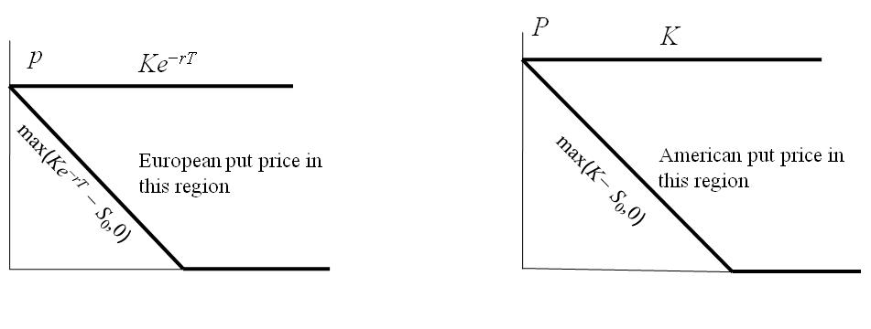
Bounds for European and American Put Options (No Dividends)

Slide 19
The Impact of Dividends on Lower Bounds to Option Prices (Equations 11.8 and 11.9, page 249)

Slide 20
Extensions of Put-Call Parity
American options; D = 0
S₀ − K < C − P < S₀ − Ke^{−rT}
Equation 11.7 p. 244
European options; D > 0
c + D + Ke ^{−rT} = p + S₀
Equation 11.10 p. 250
American options; D > 0
S₀ − D − K < C − P < S₀ − Ke ^{−rT}
Equation 11.11 p. 250

